Slide 1
Peer Review Mock-Up Demo

Slide 2
Sign up/ Log in
Brief Introductions to the app
Emory Manuscripts reviewing system
A user can login if he/she is a registered user.
A new user should sign up
Clicking “Login” will jump to “Log in” page
Clicking “Sign up” will jump to “Sign up” page
Brief Introductions to the app
New User
Log in
©2014 Copyright

Slide 3
Sing up
Emory Manuscripts reviewing system
Emory Manuscripts reviewing system
* First Name:
A new user should sign up.
The field “Number of papers reviewed in real journals” is optional.
After filling in all the required fields(*), successful sign up will redirect to “Login” page.
* Last Name:
* Email:
* Password:
* Confirm Password:
* School/ Department:
* Lab/PI:
* Research Interest:
* Research Field:
口Bio 口 CS
Finish
©2014 Copyright

Slide 4
Sign up - not all required fields are filled in
Emory Manuscripts reviewing system
Emory Manuscripts reviewing system
Name, Email can not be empty
* First Name:
* Last Name:
* Email:
* Password:
* Confirm Password:
* School/ Department:
***
* Lab/PI:
***
* Research Interest:
***
* Research Field:
口Bio 口 CS
Finish
©2014 Copyright

Slide 5
Log in
Emory Manuscripts reviewing system
User name:
Password:
Log in
©2014 Copyright

Slide 6
Log in - failure
Emory Manuscripts reviewing system
Either username or password are incorrect. Please try again.
After clicking “Log in” , if user name or password are not correct
User name:
Password:
Log in
©2014 Copyright

Slide 7
Log in - success
Emory Manuscripts reviewing system
After clicking “Log in” , if login is successful,
A normal registered user will be redirected to the normal user page.
An admin will be redirected to an admin page.
User name:
******
Password:
******
Log in
©2014 Copyright

Slide 8
Welcome page for a normal user
Emory Manuscripts reviewing system
Help | Log out
Welcome, Mike!
Clicking “Author Center” will redirect to “Author Dashboard” page.
Clicking “Referee Center” will redirect to “Reviewer Dashboard” page.
Author
Center
Referee
Center
©2014 Copyright

Slide 9
Peer Review Mock-Up Demo
For author

Slide 10
Welcome page for a normal user
Peer Review
Help | Log out
Welcome, Mike!
Clicking “Author Center” will redirect to “Author Dashboard” page.
Clicking “Referee Center” will redirect to “Reviewer Dashboard” page.
Author
Center
Referee
Center
@2014 Copyright

Slide 11
Author Dashboard
Peer Review
Help | Log out
Main Menu | Author Dashboard | Reviewer Dashboard
Author Dashboard
An author can browse the manuscripts he/she has not submitted or submitted
An author can submit a manuscript by clicking “here” on the right. After clicking the hyperlink, a manuscript submit page will come up
My Manuscripts
Author Resources
PCA versus LDA
CA versus LD
Click here to submit a new manuscript
edit
view
@2014 Copyright

Slide 12
Poll is full
Peer Review
Help | Log out
Main Menu | Author Dashboard | Reviewer Dashboard
If pool is full, show “come again later” and provide link to “Dashboard”
If pool is not full, start manuscript submission process
The pool is full. When next review session begins, we will notify you by email.
Back to Dashboard
@2014 Copyright

Slide 13
Manuscript submission-Agreement for review process
Peer Review
Help | Log out
Main Menu | Author Dashboard | Reviewer Dashboard
Manuscript submission
Before submission, the author should sign an agreement form for the review process
Clicking “Agree” will continue the submission process
Clicking “Disagree” will redirect to “Dashboard” page
Agreement for review process
………………….
…………..
………………
…………………………………..
Agree
Disagree
@2014 Copyright

Slide 14
Manuscript submission
Peer Review
Help | Log out
Main Menu | Author Dashboard | Reviewer Dashboard
Manuscript submission
Fields with (*) are required fields.
An author can click “Save”, so the information will be stored in system.
An author can click “Submit”:
If all required fields are filled in, system will show a manuscript submission success message and send confirmation email
Otherwise, show a message which field is not filled in.
* Title:
* Abstract:
* Keywords (10):
* Target journal:
* Manuscript filed:
☑Bio 口 CS
Upload files:
* Text part(.doc or .pdf)
Tables (.doc or .pdf)
Figures (.png)
Select files
Add
Select files
Add
Select files
Add
Save
Submit
@2014 Copyright

Slide 15
Manuscript submission- Success
Peer Review
Help | Log out
Main Menu | Author Dashboard | Reviewer Dashboard
Manuscript submission
Your manuscript (ID: XXXXX) has been submitted successfully.
Back to Dashboard
@2014 Copyright

Slide 16
Peer Review Mock-Up Demo
For reviewer

Slide 17
Emory Manuscripts reviewing system
Brief Introductions to the app
Home
New User
Log in
©2014 Copyright
Emory Manuscripts reviewing system
Help | Log out
Welcome, Mike!
User Dashboard
Author
Center
Reviewer
Center
©2014 Copyright

Slide 18
Emory Manuscripts reviewing system
Help | Log out
Oops, not a reviewer in current session ?
New reviewer
Become a reviewer
Before deadline 1
back
©2014 Copyright
Emory Manuscripts reviewing system
Help | Log out
New reviewer
Oops, you are not a reviewer in current session
And the reviewer registration is closed
We will notify you by email when next session begins
After deadline 1
back
©2014 Copyright

Slide 19
Emory Manuscripts reviewing system
Peer Review
Help | Log out
Help | Log out
Confidentiality Form
Become a reviewer
I have read the confidentiality form
Agree
Disagree
©2014 Copyright
Emory Manuscripts reviewing system
Peer Review
Help | Log out
Help | Log out
How many papers have you reviewed for journals?
Agree
Less than 3
3 or more
©2014 Copyright

Slide 20
Emory Manuscripts reviewing system
Peer Review
Help | Log out
Thank you for registering as a reviewer!
You can browse our manuscript list and show your interest. However, the manuscript we will assign to you might be a different one.
©2014 Copyright
Emory Manuscripts reviewing system
Peer Review
Help | Log out
Notice: Deadline for review accomplishment is
Jan – 11 – 2015
Browse Manuscript list
My assigned manuscripts
back
©2014 Copyright

Slide 21
Emory Manuscripts reviewing system
Peer Review
Help | Log out
Help | Log out
Click the checkbox if you want to review it
Browse Manuscript list
Title
abstract
Title
abstract
Title
abstract
Page 《Prev 1 2 3 Next》
Finish
©2014 Copyright
Emory Manuscripts reviewing system
Peer Review
Help | Log out
Help | Log out
Title
Abstract
abstract
I feel good to review this manuscript
back
©2014 Copyright

Slide 22
Emory Manuscripts reviewing system
Peer Review
Help | Log out
Help | Log out
Please upload your finished review form by Deadline
My assigned manuscripts
Empty Review Form
Download
Manuscript Title
Download
Review form has been uploaded
Upload new
back
©2014 Copyright
Emory Manuscripts reviewing system
Peer Review
Help | Log out
Help | Log out
Please upload your finished review form by Deadline
My assigned manuscripts
Empty Review Form
Download
Manuscript Title
Download
Review form has NOT been uploaded
Upload form
back
©2014 Copyright

Slide 23
Peer Review Mock-Up Demo
For admin

Slide 24
Admin Log in
Peer Review
After clicking “Log in” , if login is successful
An admin will be redirected to an admin page.
User name:
mike@emory.edu
Password:
********
Log in
@2014 Copyright

Slide 25
Manuscripts/Reviewers -view mode
Peer Review
Help | Log out
Manuscripts/Reviewers | Settings
Manuscripts:
……..
Admin can browse the list manuscripts/reviewers
Advanced reviewers will be shown with star sign(*); beginner reviewers will be shown without star sign
Admin can edit reviewers for a manuscript if the final matching decision hasn’t been made by clicking “edit”
“submit” will be enabled only if the current assignment matches matching constraints
PCA versus LDA (ID:XXXXX)
Author: Martinez, A.
Assigned reviewers: John Lee*, Emily White
Recommend reviewers: Mary Green*, …
submit
edit
deadlines
meeting
feedback
Eigenfaces for Recognition (ID:XXXXX)
Author: Martinez, A.
Reviewers: John Lee*, Jim Lee, John Green,…
deadlines
meeting
feedback
Reviewers:
Advanced reviewers: John Lee *, Mary Green*,….
Beginner reviewers: Emily White, Jim Chen, Jim Chen,….
@2014 Copyright

Slide 26
Manuscripts/Reviewers -edit mode
Peer Review
Help | Log out
Manuscripts/Reviewers | Settings
Manuscripts:
……..
After clicking “edit”
Admin can select/unselect reviewers listed on the screen using checkboxes
Admin can add other unlisted reviewers on the screen by clicking “add”
Admin can save and finish editing by clicking “finish edit”. After finishing editing, user will exit edit mode and go back to view mode.
PCA versus LDA (ID:XXXXX)
Author: Martinez, A.
Assigned reviewers: ☑John Lee*, 口 Emily White
Recommend reviewers: ☑ Mary Green*, …
finish edit
add
Eigenfaces for Recognition (ID:XXXXX)
Author: Martinez, A.
Reviewers: John Lee*, Jim Lee, John Green,…
deadlines
meeting
feedback
Reviewers:
Advanced reviewers: John Lee *, Mary Green*,….
Beginner reviewers: Emily White, Jim Chen, Jim Chen,….
@2014 Copyright

Slide 27
Manuscripts/Reviewers -add reviewers to screen
Peer Review
Help | Log out
Manuscripts/Reviewers | Settings
Manuscripts:
……..
After clicking “add”
Admin can use checkboxes to select reviewers from reviewer list and add them to the screen
PCA versus LDA (ID:XXXXX) Author: Martinez, A.
Assigned reviewers: ☑John Lee*, 口 Emily White
Recommend reviewers: ☑ Mary Green*, …
✗
☑ Jim Chen
口 Holly Green*
….
….
finish edit
add
Eigenfaces for Recognition (ID:XXXXX)
Author: Martinez, A.
Reviewers: John Lee*, Jim Lee, John Green,…
deadlines
meeting
feedback
ok
Reviewers:
Advanced reviewers: John Lee *, Mary Green*,….
Beginner reviewers: Emily White, Jim Chen , Jim Chen,….
@2014 Copyright

Slide 28
Manuscripts/Reviewers
Peer Review
Help | Log out
Manuscripts/Reviewers | Settings
Manuscripts:
……..
New selected reviewer is shown on the screen
PCA versus LDA (ID:XXXXX)
Author: Martinez, A.
Assigned reviewers: ☑John Lee*, 口 Emily White,
Recommend reviewers: ☑ Mary Green*, …
Added reviewers: ☑ Jim Chen…
finish edit
add
Eigenfaces for Recognition (ID:XXXXX)
Author: Martinez, A.
Reviewers: John Lee*, Jim Lee, John Green,…
deadlines
meeting
feedback
Reviewers:
Advanced reviewers: John Lee *, Mary Green*,….
Beginner reviewers: Emily White, Jim Chen , Jim Chen,….
@2014 Copyright

Slide 29
Manuscripts/Reviewers -finish editing
Peer Review
Help | Log out
Manuscripts/Reviewers | Settings
Manuscripts:
……..
After click “finish edit” and all matching constraints satisfied
PCA versus LDA (ID:XXXXX)
Author: Martinez, A.
Assigned reviewers: ☑John Lee*, ☒Emily White,
Recommend reviewers: ☑ Mary Green*, ☑ Jim Chen…
Your current assignment for the following manuscript has been saved.
PCA versus LDA (ID:XXXXX)
Author: Martinez, A.
Reviewers: John Lee*, Emily White, Mary Green*, Jim Chen…
Do you want to submit the final matching decision?
✗
finish edit
add
Eigenfaces for Recognition (ID:XXXXX)
Author: Martinez, A.
Reviewers: John Lee*, Jim Lee, John Green,…
deadlines
meeting
feedback
Reviewers:
Advanced reviewers: John Lee *, Mary Green*,….
Beginner reviewers: Emily White, Jim Chen , Jim Chen,….
No
Yes
@2014 Copyright

Slide 30
Manuscripts/Reviewers -confirm submitting decision
Peer Review
Help | Log out
Manuscripts/Reviewers | Settings
Manuscripts:
……..
After click “yes”
PCA versus LDA (ID:XXXXX)
Author: Martinez, A.
Assigned reviewers: ☑John Lee*, ☒Emily White,
Recommend reviewers: ☑ Mary Green*, ☑ Jim Chen…
✗
Confirm the final matching decision for the following manuscript:
PCA versus LDA (ID:XXXXX)
Author: Martinez, A.
Reviewers: John Lee*, Emily White, Mary Green*, Jim Chen…
finish edit
add
Eigenfaces for Recognition (ID:XXXXX)
Author: Martinez, A.
Reviewers: John Lee*, Jim Lee, John Green,…
deadlines
meeting
feedback
No
Yes
Reviewers:
Advanced reviewers: John Lee *, Mary Green*,….
Beginner reviewers: Emily White, Jim Chen , Jim Chen,….
@2014 Copyright

Slide 31
Manuscripts/Reviewers
Peer Review
Help | Log out
Manuscripts/Reviewers | Settings
Manuscripts:
……..
After click “yes”
PCA versus LDA (ID:XXXXX)
Author: Martinez, A.
Assigned reviewers: ☑John Lee*, ☒Emily White,
Recommend reviewers: ☑ Mary Green*, ☑ Jim Chen…
✗
Your decision for the following manuscript:
PCA versus LDA (ID:XXXXX)
Author: Martinez, A.
Reviewers: John Lee*, Emily White, Mary Green*, Jim Chen…
has been made. We have successfully send emails to the author and reviewers about the decision.
finish edit
add
Eigenfaces for Recognition (ID:XXXXX)
Author: Martinez, A.
Reviewers: John Lee*, Jim Lee, John Green,…
deadlines
meeting
feedback
Reviewers:
Advanced reviewers: John Lee *, Mary Green*,….
Beginner reviewers: Emily White, Jim Chen , Jim Chen,….
ok
@2014 Copyright

Slide 32
Manuscripts/Reviewers -matching constraints not satisfied
Peer Review
Help | Log out
Manuscripts/Reviewers | Settings
Manuscripts:
……..
After click “finish edit” and some matching constraints satisfied
After click “finish edit” or “continue edit”, the system will rerun the matching algorithm and give new recommendations based on admin’s updated assignment of reviewers
PCA versus LDA (ID:XXXXX)
Author: Martinez, A.
Assigned reviewers: ☑John Lee*, ☒Emily White,
Recommend reviewers: ☑ Mary Green*, ☑ Jim Chen…
Your current assignment for the following manuscript has been saved.
PCA versus LDA (ID:XXXXX)
Author: Martinez, A.
Reviewers: John Lee*, Emily White, Mary Green, Jim Chen…
However, matching constraints are not satisfied and the decision can’t be finalized.
Reason: The number of advanced reviewers is less than 2.
✗
finish edit
add
Eigenfaces for Recognition (ID:XXXXX)
Author: Martinez, A.
Reviewers: John Lee*, Jim Lee, John Green,…
deadlines
meeting
feedback
Reviewers:
Advanced reviewers: John Lee *, Mary Green*,….
Beginner reviewers: Emily White, Jim Chen , Jim Chen,….
finish edit
continue edit
@2014 Copyright

Slide 33
Settings
Peer Review
Help | Log out
Manuscripts/Reviewers | Settings
Max. number of manuscripts:
Number of manuscripts should be less than 10.
edit
Deadlines and email reminder dates:
Manuscript submission and reviewers showing interests
Deadline: Oct. 15 2014.
Email reminder dates: 1, 7 days before deadline.
Review accomplishment
Deadline: Nov. 15 2014.
Email reminder dates: 1, 7 days before deadline.
edit
Meetings:
Email reminder dates: 1, 3 days before meeting time
edit
@2014 Copyright

Slide 34
Peer-Review App (Version 1.0)
Version 1.0 should be deliverable at the end of the semester
normal users can login or sign up
author can upload manuscript
reviewer can browse list of manuscripts
reviewer can show his/her interests in manuscripts
reviewer can pickup assigned manuscripts
reviewer can upload review form
admin can login
admin can browse list of manuscripts/reviewers
admin can make final decisions of manuscript-reviewer matching based on our system's recommendations

Slide 35
Peer-Review App
Features won’t be implemented in version 1.0:
setting up deadlines and email reminder dates
accommodating and making final decision about meetings.
requesting and viewing feedbacks
setting up maximum number of manuscripts

Slide 36
Q & A

Slide 37
From Ben

Slide 38
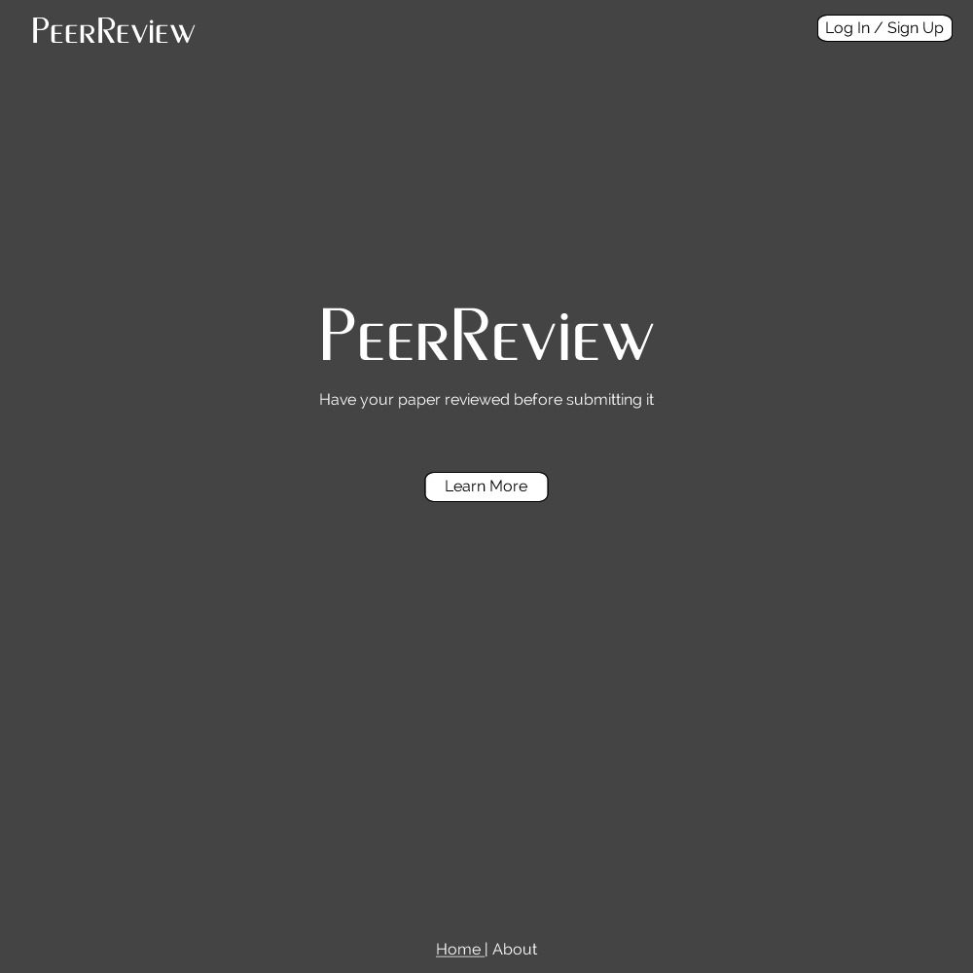
Landing Page
I was goofing around with Fireworks and made some mockups. They don’t have all the feature described above yet but they might help us visualize this more easily. I didn’t look at this document before I made the mockups so I will definitely change mine a lot.

Slide 39
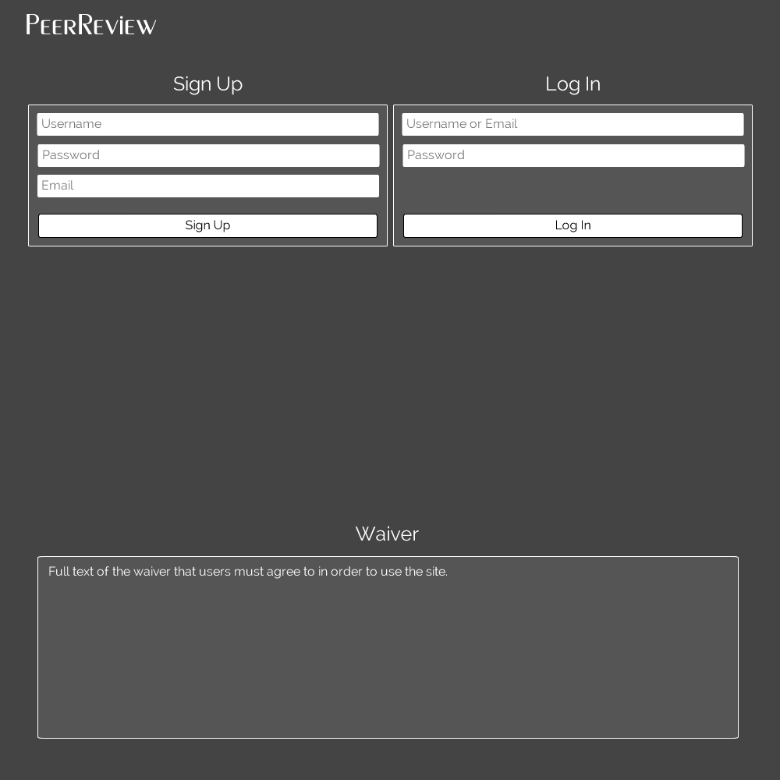
Sign Up / Login Page
The waiver at the bottom is what they must agree to when they sign up.

Slide 40
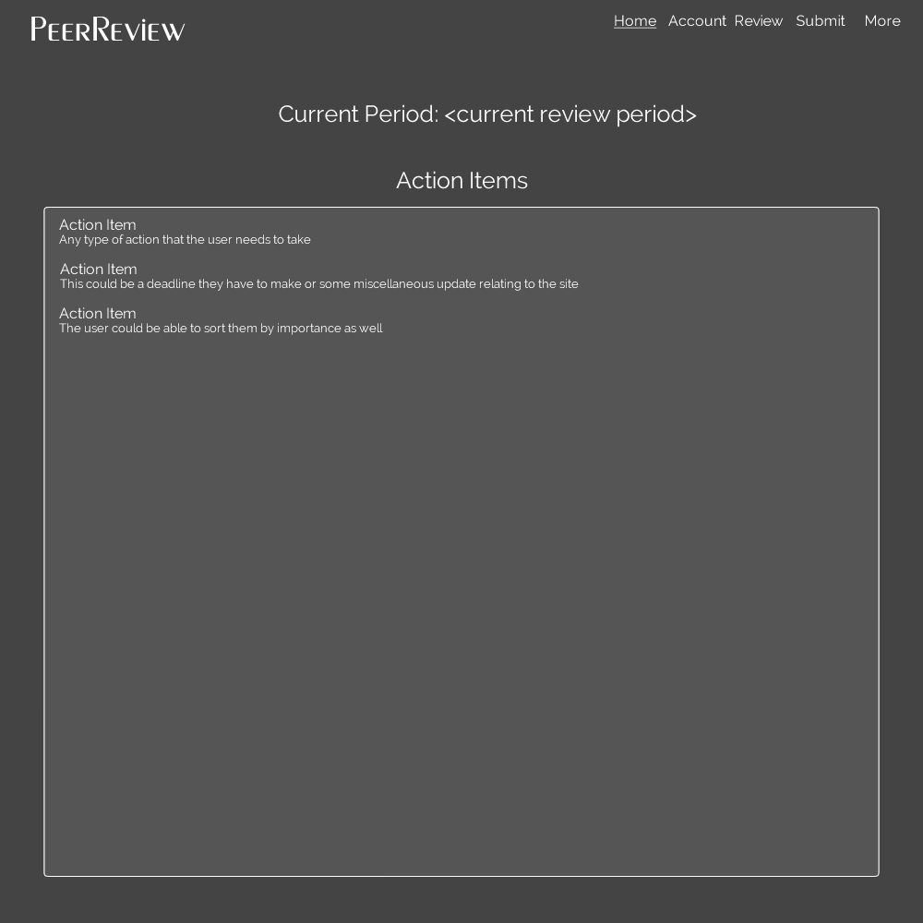
Home Page
See all the action items

Slide 41
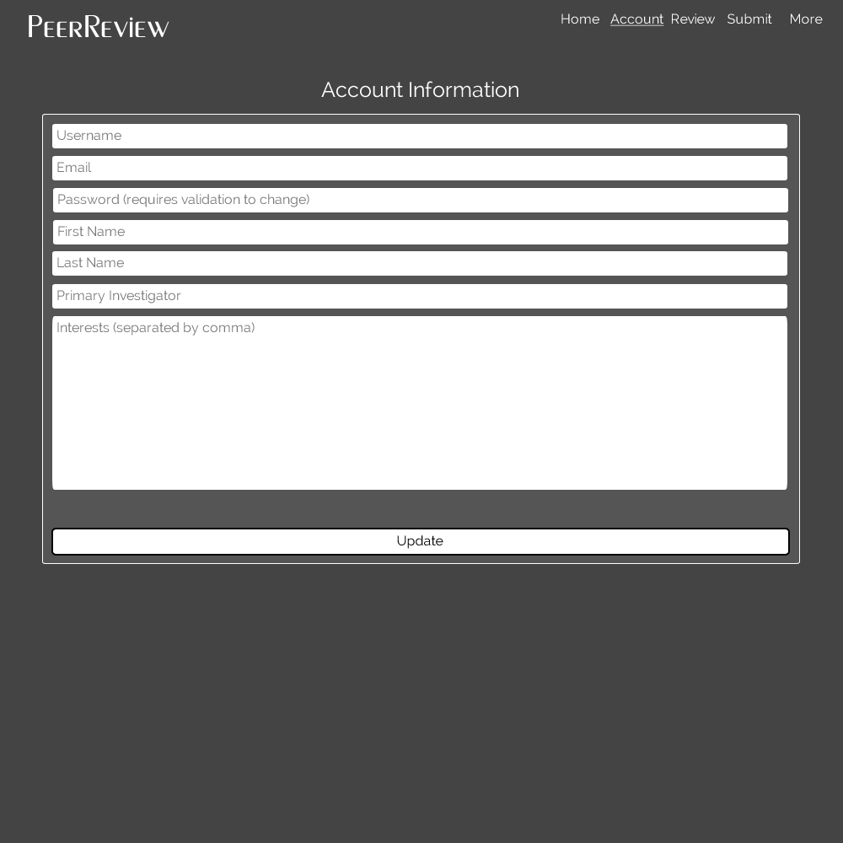
Account Management
Manage account information

Slide 42
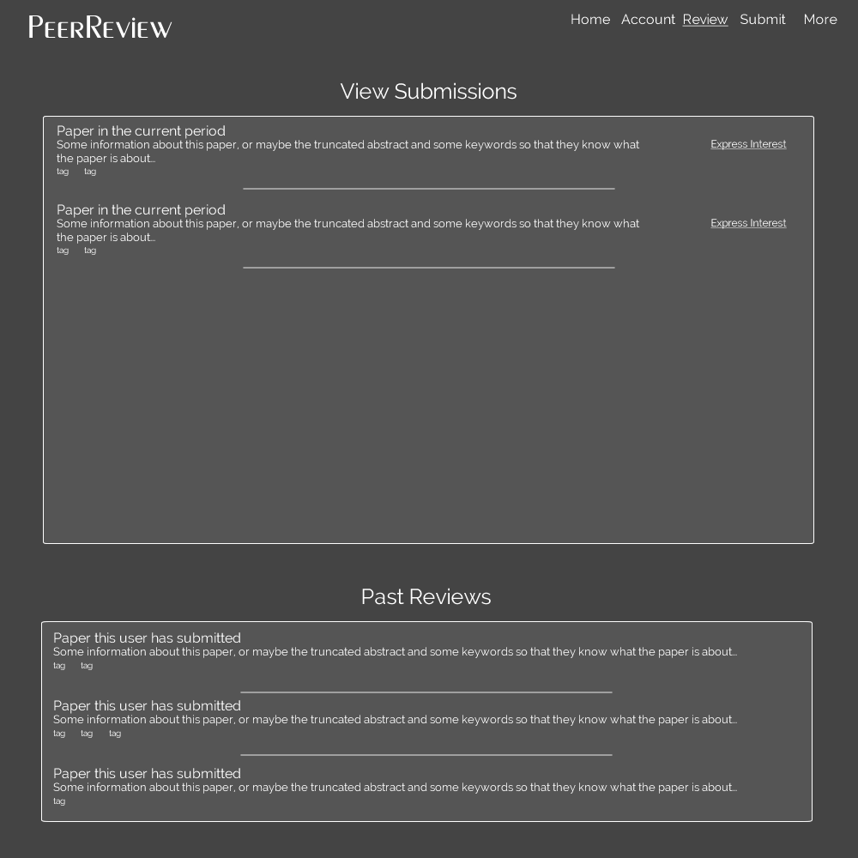
Reviewer Dashboard
View papers that have been submitted and express interest. Also view past reviews.

Slide 43
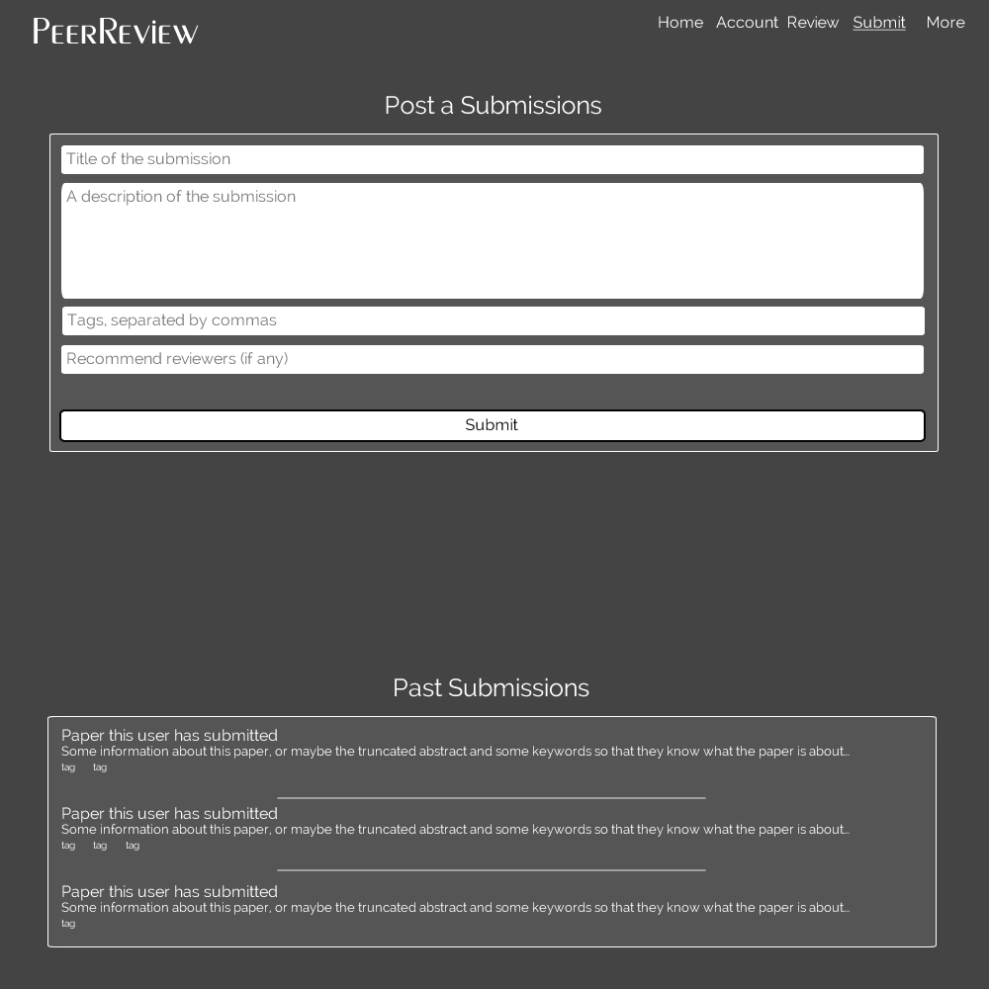
Submission Dashboard
Submit papers

